Slide 1
Machine Learning
Lecture 18:
Decision Tree / Bagging
Dr. Beilun Wang
Southeast University
School of Computer Science
and Engineering

Slide 2
Course Content Plan
Regression (supervised)
Classification (supervised)
Unsupervised models
Learning theory
Y is a continuous
Y is a discrete
NO Y
About f()
Graphical models
About interactions among X1,… Xp
Reinforcement Learning
Learn program to Interact with its environment

Slide 3
Three major sections for classification
We can divide the large variety of classification approaches into roughly three major types
Discriminative
directly estimate a decision rule/boundary
e.g., support vector machine, decision tree, logistic regression, e.g. neural networks (NN), deep NN
Generative:
build a generative statistical model
e.g., Bayesian networks, Naïve Bayes classifier
Instance based classifiers
Use observation directly (no models)
e.g. K nearest neighbors

Slide 4
Decision Tree / Random Forest
 |  | Classification Partition feature space into set of rectangles, local smoothness Greedy to find partitions Split with Purity measure / e.g. IG / cross-entropy / Gini / Tree Model (s), i.e. space partition
Task Representation Score Function Search/Optimization Models, Parameters

Slide 5
Today
Decision Tree (DT):
Tree representation
Brief information theory
Learning decision trees
Bagging
Random forests: Ensemble of DT
More about ensemble

Slide 6
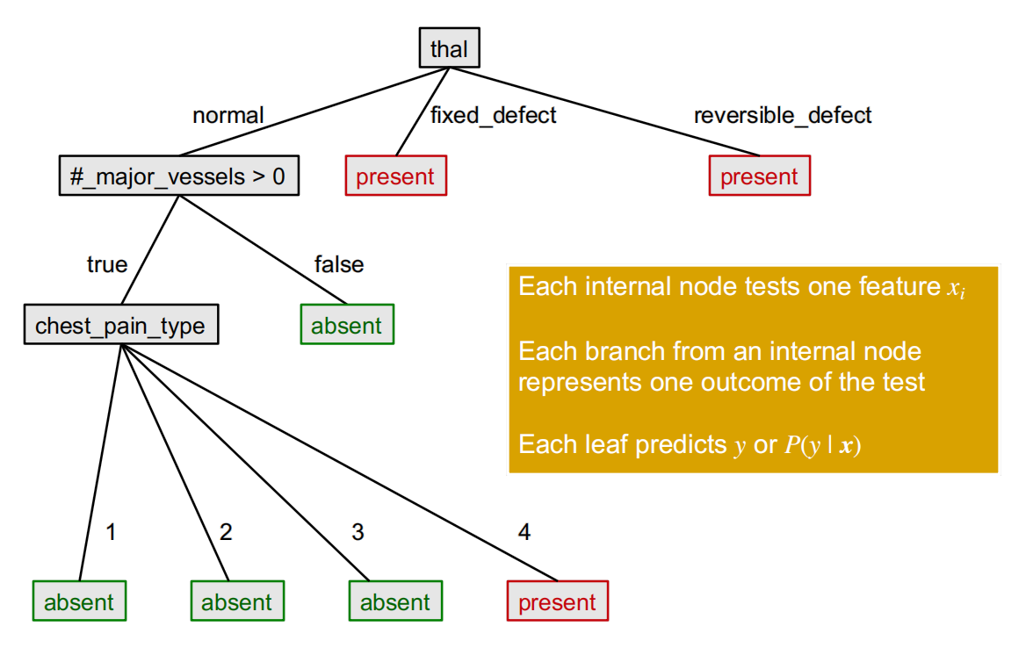
A decision tree to predict heart disease

Slide 7
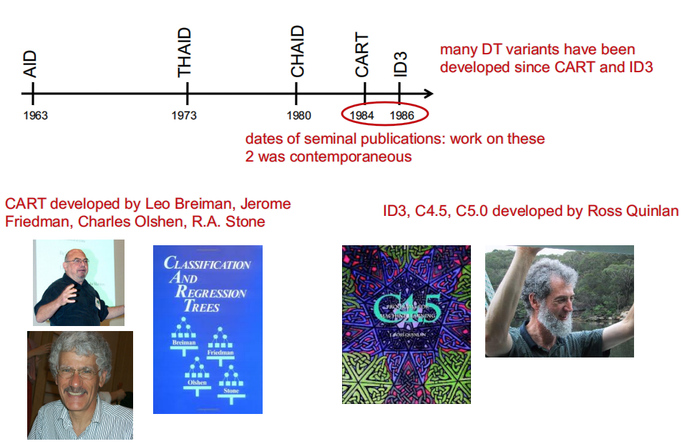
History of decision tree learning

Slide 8

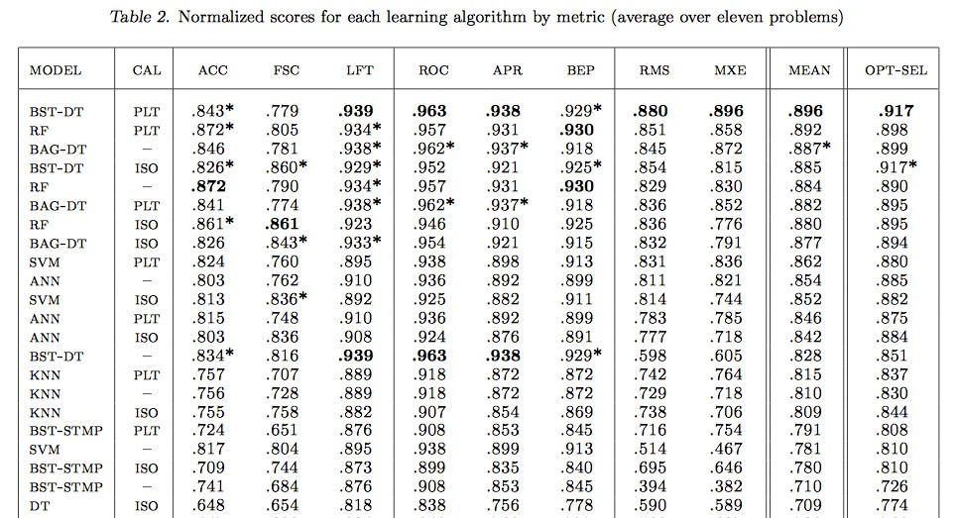

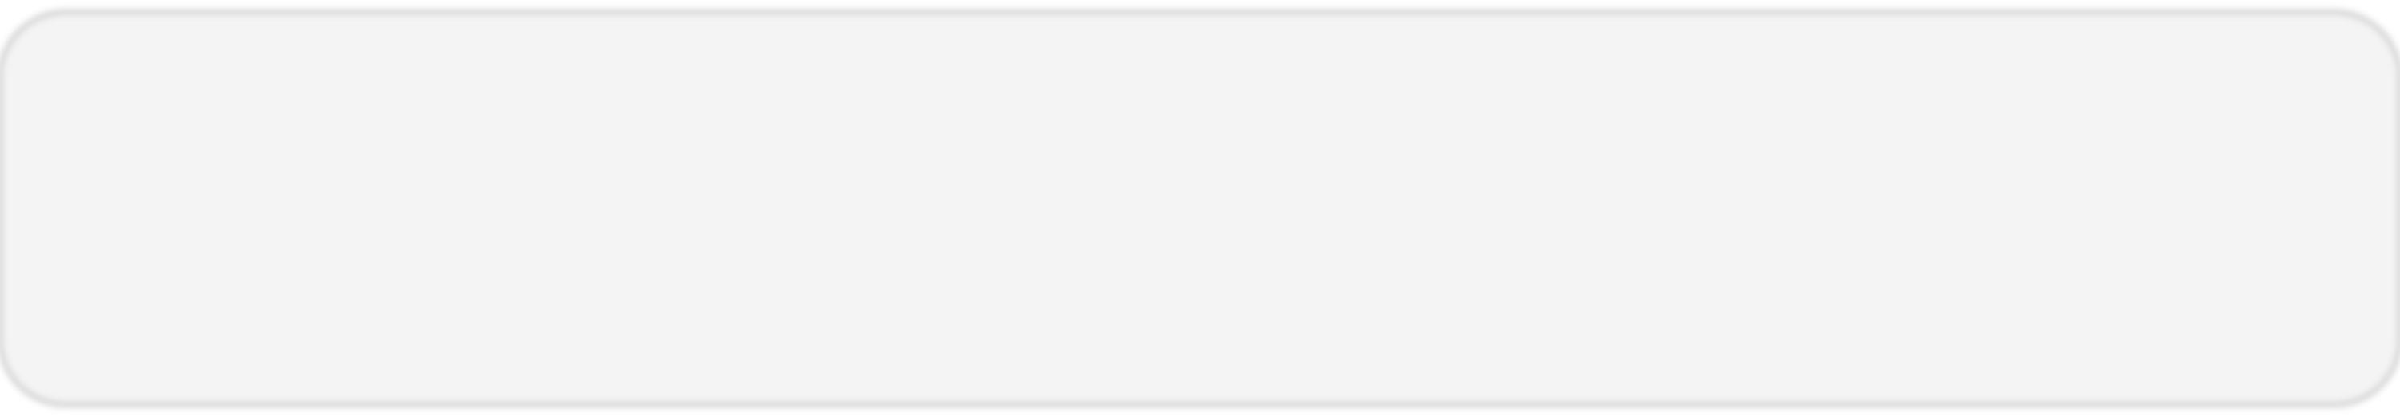
A study comparing Classifiers → 11 binary classification problems / 8 metrics
Top 8 Models

Slide 9
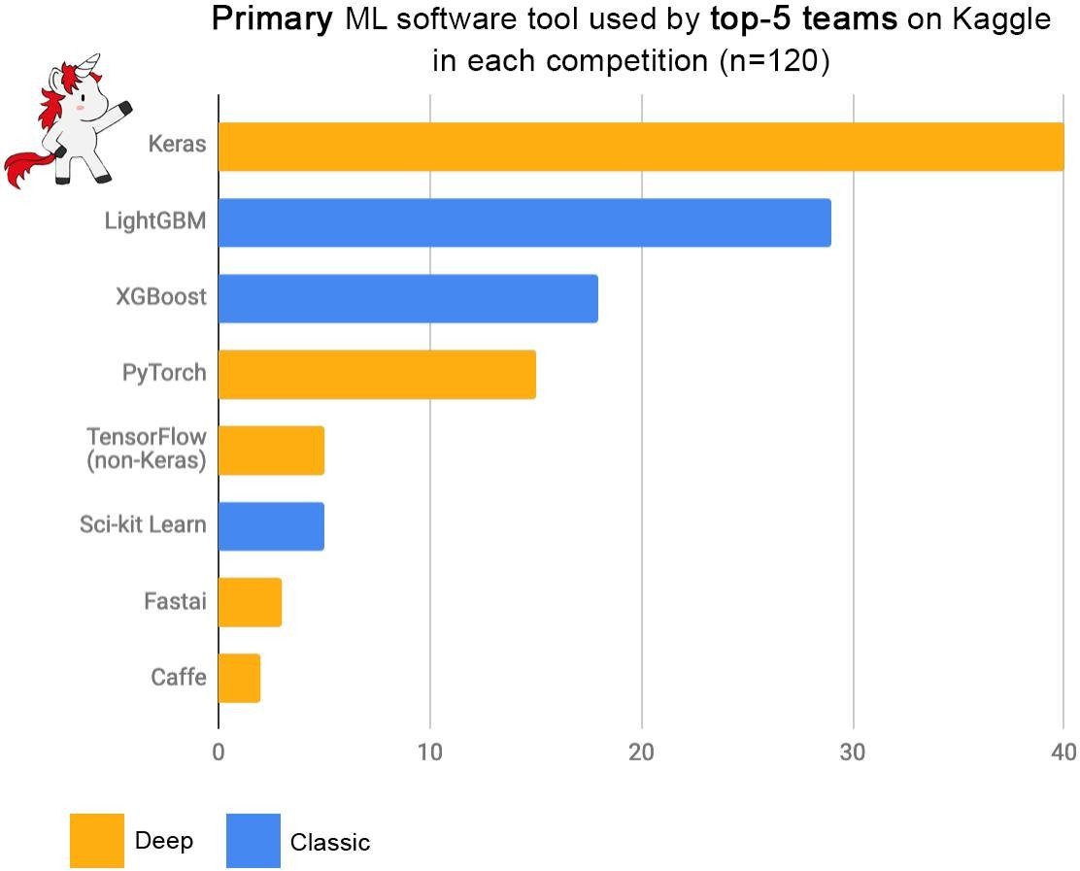
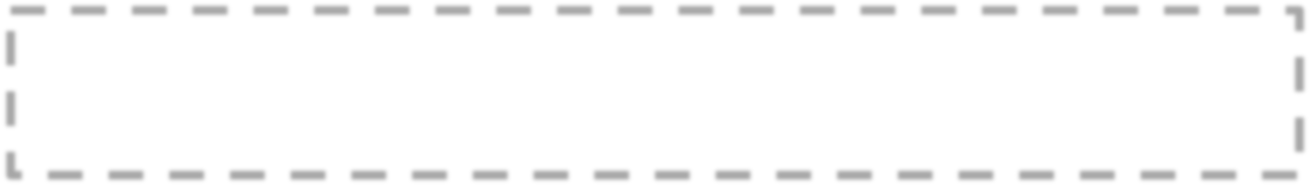
From: François Chollet 2019

Slide 10

Readability Hierarchy
Readable
Decision Trees: Classifies based on a series of one-variable decisions.
Linear Classifier: Weight vector w tells us how important each variable is for classification and in which direction it points.
Quadratic Classifier: Linear weights work as in linear classifier, with additional information coming from all products of variables.
k Nearest Neighbors: Classifies using the complete training set, no information about the nature of the class difference

Slide 11
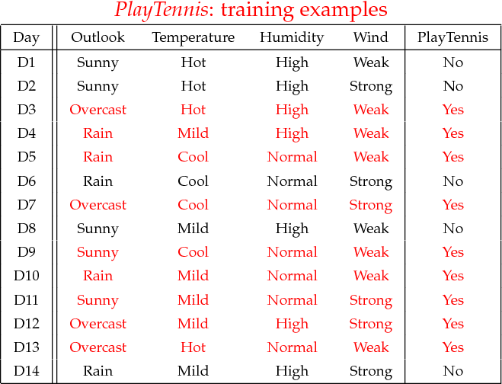


Example: Play Tennis

Slide 12
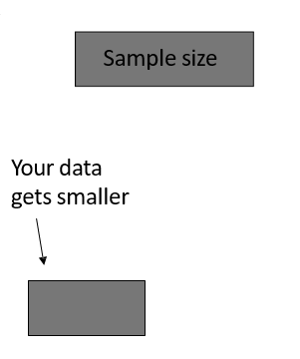
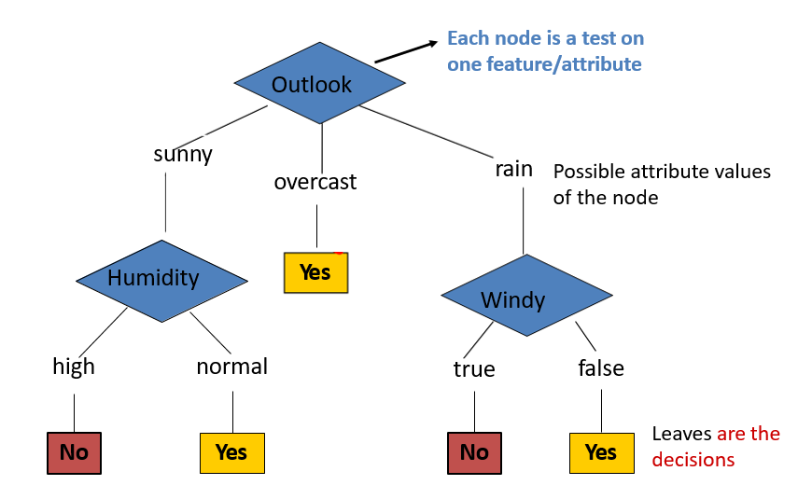

Anatomy of a decision tree

Slide 13
Apply Model to Test Data: To ‘play tennis’ or not.
A new test example: (Outlook==rain) and (Windy==false)
Outlook
sunny
Pass it on the tree
-> Decision is yes.
overcast
rain
Humidity
Yes
Windy
high
normal
true
false
No
Yes
No
Yes

Slide 14


Apply Model to Test Data: To ‘play tennis’ or not.
(Outlook ==overcast) -> yes (Outlook==rain) and (Windy==false) ->yes
Outlook
(Outlook==sunny) and (Humidity=normal) ->yes
sunny
overcast
rain
Three cases of “YES”
Humidity
Yes
Windy
high
normal
true
false
No
Yes
No
Yes

Slide 15
Decision trees (on Discrete)
Decision trees represent a disjunction of conjunctions of constraints on the attribute values of instances.
(Outlook ==overcast)
OR
((Outlook==rain) and (Windy==false))
OR
((Outlook==sunny) and (Humidity=normal))
=> yes play tennis

Slide 16
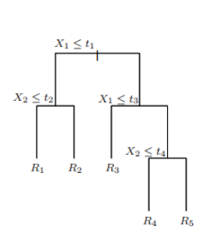
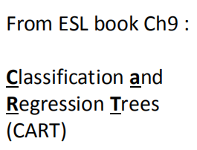
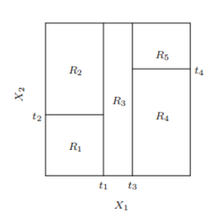
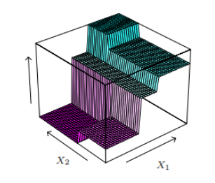
Decision trees (on Continuous)
Partition feature space into set of rectangles
Fit simple model in each partition

Slide 17




Decision Tree / Random Forest
Classification
Task
Partition feature space into set of rectangles, local smoothness
Representation
Score Function
Greedy to find partitions
Search/Optimization
Split with Purity measure /
e.g. IG / cross-entropy / Gini /
Models, Parameters
Tree Model (s), i.e. space partition

Slide 18
Today
Decision Tree (DT):
Tree representation
Brief information theory
Learning decision trees
Bagging
Random forests: Ensemble of DT
More about ensemble

Slide 19
Challenge in Tree Representation
Y=((A and B) or ((not A) and C))
0
A
1
C
B
0
1
0
1
false
true
false
true

Slide 20
Same concept / different representation
Y=((A and B) or ((not A) and C))
0
A
1
C
B
Not unique
0
1
0
1
false
true
false
true
0
C
1
B
A
0
1
1
0
false
A
false
true
1
0
true
false

Slide 21
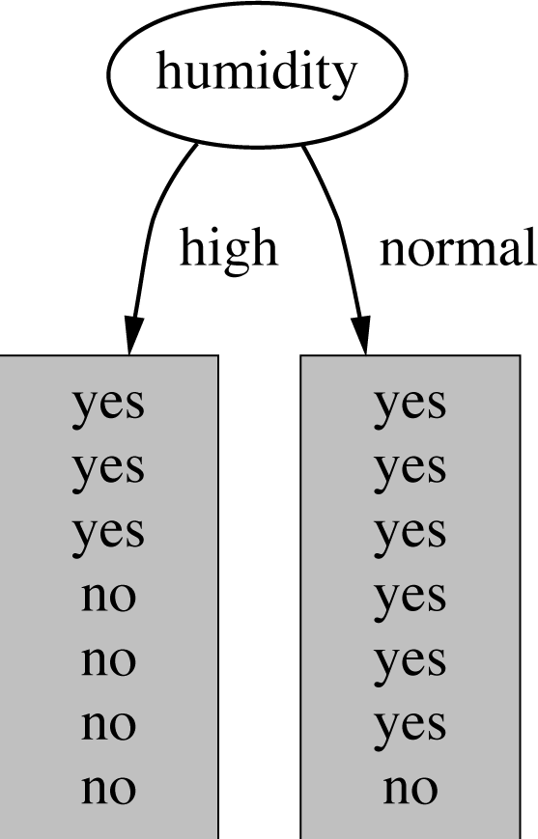

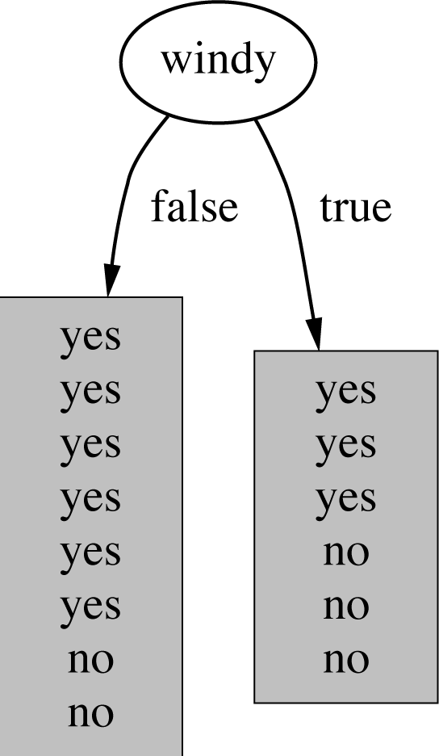

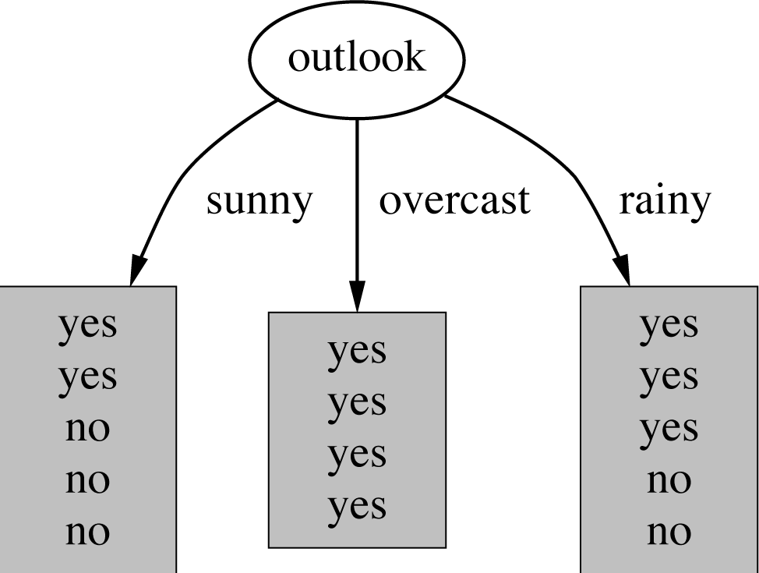
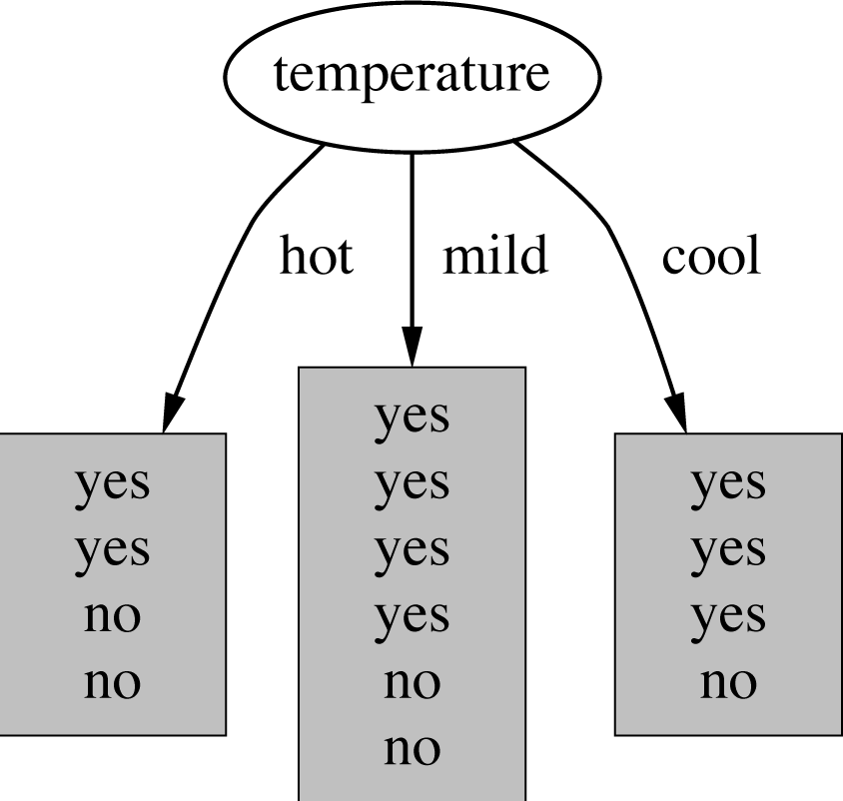







How do we choose which attribute to split ?
Which attribute should be used first to test?
Intuitively, you would prefer the one that separates the training examples as much as possible.
$$(3Y,4N)$$
$$(6Y,1N)$$
$$(2Y,3N)$$
$$(4Y,0N)$$
$$(3Y,2N)$$
$$(3Y,3N)$$
$$(6Y,2N)$$

Slide 22
one criteria: Information gain
Imagine:
Someone is about to tell you your own name
You are about to observe the outcome of a dice roll
You are about to observe the outcome of a coin flip
You are about to observe the outcome of a biased coin flip
Each situation has a different amount of uncertainty as to what outcome you will observe.

Slide 23
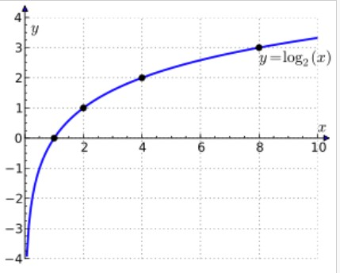
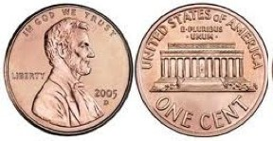

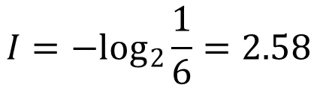
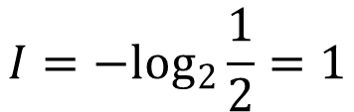
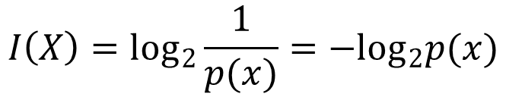
Information
Dr. Yanjun Qi / UVA CS
Information: Reduction in uncertainty (amount of surprise in the outcome)
$$I\left(X\right)=\log_{2}\frac{1}{p(x)}=−\log_{2}p(x)$$
If the probability of this event happening is small and it happens, the information is large.
$$I=−\log_{2}\frac{1}{2}=1$$
Observing the outcome of a coin flip is head
$$I=−\log_{2}\frac{1}{6}=2.58$$
Observe the outcome of a dice is 6

Slide 24
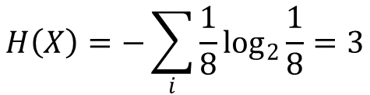
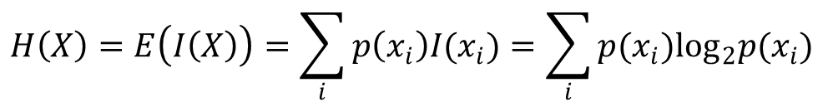
Entropy
The expected amount of information when observing the output of a random variable X
If the X can have 8 outcomes and all are equally likely
$$H\left(X\right)=E\left(I\left(X\right)\right)=\sum_{i}{p\left(x_{i}\right)I(x_{i})}=\sum_{i}{p(x_{i})\log_{2}p(x_{i})}$$
$$H\left(X\right)=−\sum_{i}{\frac{1}{8}\log_{2}\frac{1}{8}}=3$$

Slide 25
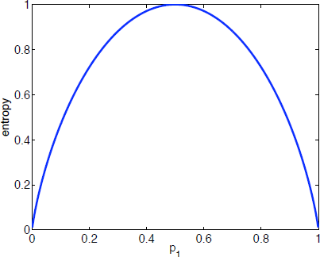

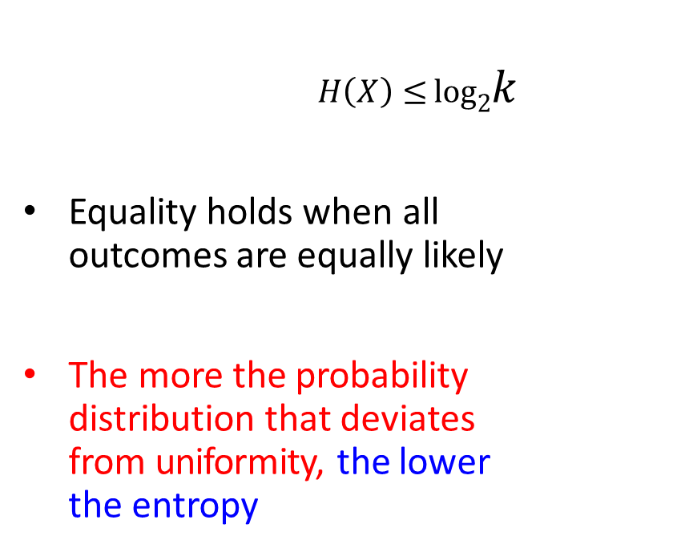


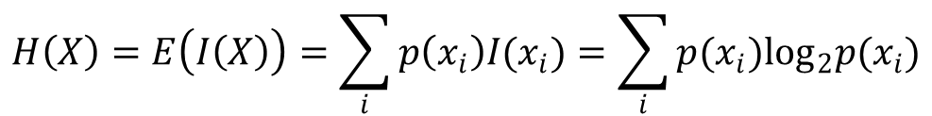
Entropy
$$H \left( X \right)≤log2k$$
Equality holds when all outcomes are equally likely
The more the probability distribution that deviates from uniformity, the lower the entropy
If there are k possible outcomes
Binary
$$H(X)$$
$$\frac{1}{2}$$
$$H\left(X\right)=E\left(I\left(X\right)\right)=\sum_{i}{p\left(x_{i}\right)I(x_{i})}=\sum_{i}{p(x_{i})\log_{2}p(x_{i})}$$
$$p(H)$$
e.g. for a random binary variable

Slide 26




Entropy Lower → better purity
Entropy measures the purity
$$P_{Yes}=P=\frac{4}{8}$$
$$P=\frac{8}{8}=1=P_{Yes}$$
4 +
4 -
8 +
0 -
$$1−P=0=P_{No}$$
$$P_{No}=1−P=\frac{4}{8}$$
The distribution is less uniform Entropy is lower
The node is purer

Slide 27
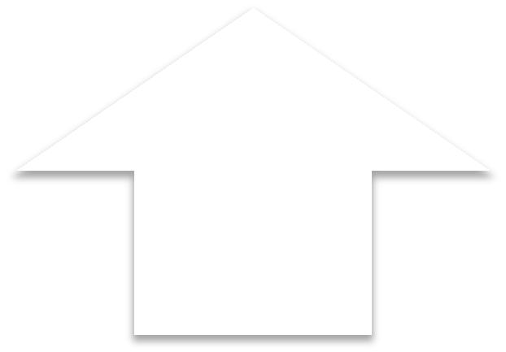
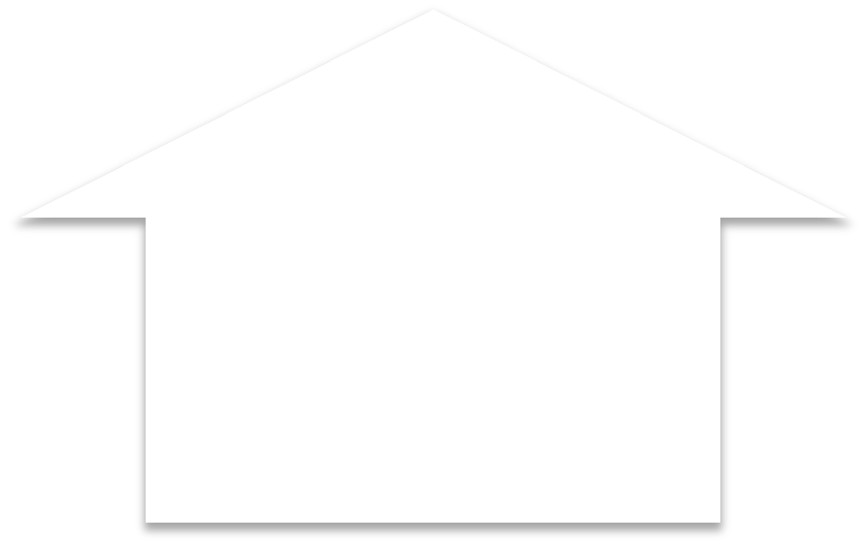
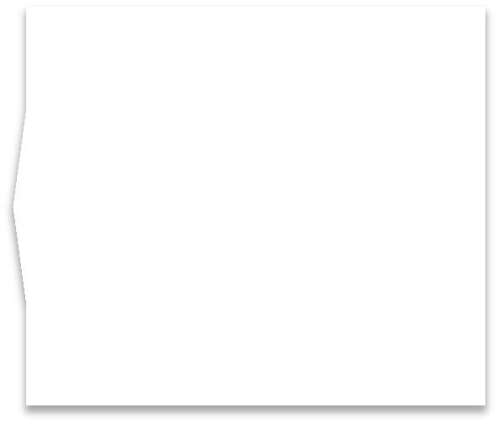



Information gain
$IG(X,Y)=H(Y)−H(Y|X)$
Reduction in uncertainty of Y by knowing a feature variable X
Information gain:
= (information before split) – (information after split)
= entropy(parent) – [average entropy(children)]
–
For IG, the higher, the better
Fixed
the lower, the better (children nodes are purer)
=

Slide 28
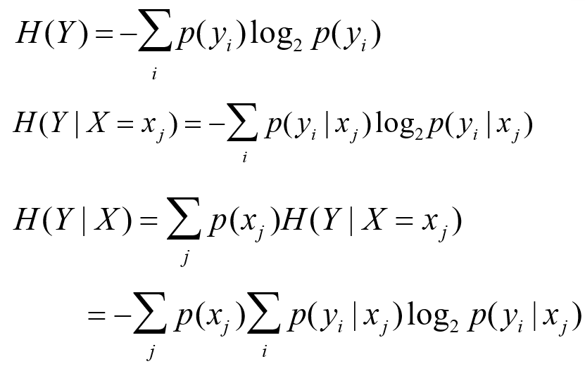
Conditional entropy

Slide 29





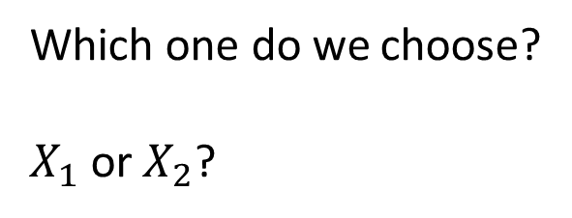







Example
Attributes
Labels
X1 | X2 | Y | Count
T | T | + | 2
T | F | + | 2
F | T | - | 5
F | F | + | 1
Which one do we choose?
$X_{1}$ or $X_{2}$?
$$5+，5−$$
$$X_{1}$$
$$5+，5−$$
$$X_{2}$$
$$T$$
$$F$$
$$T$$
$$F$$
$$4+，0−$$
$$1+，5−$$
$$2+，5−$$
$$3+，0−$$

Slide 30









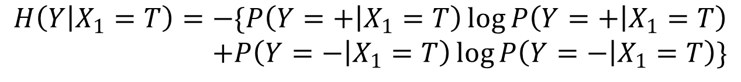


Example
X1 | X2 | Y | Count
T | T | + | 2
T | F | + | 2
F | T | - | 5
F | F | + | 1
$$5+，5−$$
$$X_{1}$$
$$\frac{4}{10}$$
$$\frac{6}{10}$$
$$T$$
$$F$$
$$4+，0−$$
$$1+，5−$$
$$H\left(Y | X_{1}=T\right)=−\{P\left(Y=+ | X_{1}=T\right)\log{P\left(Y=+ | X_{1}=T\right)}$$
$$+P\left(Y=− | X_{1}=T\right)\log{P\left(Y=− | X_{1}=T\right)}\}$$
$$⇒$$
$$4+，0−$$
$$=0$$

Slide 31


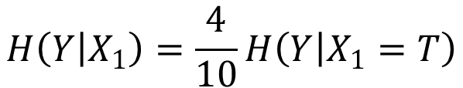










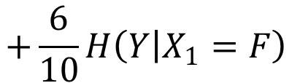
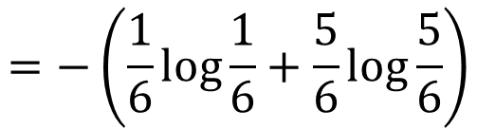

4+
0-
$$H\left(Y | X_{1}=T\right)=$$
$$⇒$$
$$−(P\left(+\right)\log\left(P\left(+\right)\right)+P\left(−\right)\log\left(P\left(−\right)\right))$$
$$=−\left(1\log{1}+0\log{0}\right)=0$$
1+
5-
$$H\left(Y | X_{1}=F\right)=$$
$$⇒$$
$$−(P\left(+\right)\log\left(P\left(+\right)\right)+P\left(−\right)\log\left(P\left(−\right)\right))$$
$$=−\left(\frac{1}{6}\log{\frac{1}{6}}+\frac{5}{6}\log{\frac{5}{6}}\right)$$
$$5+，5−$$
$$X_{1}$$
$$H\left(Y | X_{1}\right)=\frac{4}{10}H\left(Y | X_{1}=T\right)$$
$$\frac{4}{10}$$
$$\frac{6}{10}$$
$$T$$
$$F$$
$$+\frac{6}{10}H\left(Y | X_{1}=F\right)$$
$$4+，0−$$
$$1+，5−$$

Slide 32
Example
Attributes
Labels
X1 | X2 | Y | Count
T | T | + | 2
T | F | + | 2
F | T | - | 5
F | F | + | 1
Which one do we choose?
$X_{1}$ or $X_{2}$?
IG(X1,Y) = H(Y) – H(Y|X1)
H(Y) = - (5/10) log(5/10) - 5/10log(5/10) = 1
H(Y|X1) = P(X1=T)H(Y|X1=T) + P(X1=F) H(Y|X1=F)
= 4/10 (1log 1 + 0 log 0) +6/10 (5/6log 5/6 +1/6log1/6)
= 0.39
Information gain (X1,Y) = 1 - 0.39 = 0.61

Slide 33
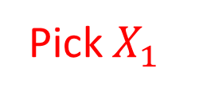
Which one do we choose?
Attributes
Labels
X1 | X2 | Y | Count
T | T | + | 2
T | F | + | 2
F | T | - | 5
F | F | + | 1
Which one do we choose?
$X_{1}$ or $X_{2}$?
Information gain (X1,Y) = 0.61 Information gain (X2,Y) = 0.12
Pick the variable which provides the most information gain about Y
Pick $X_{1}$

Slide 34


Which one do we choose?
X1 | X2 | Y | Count
T | T | + | 2
T | F | + | 2
F | T | - | 5
F | F | + | 1
X1 | X2 | Y | Count
T | T | + | 2
T | F | + | 2
F | T | - | 5
F | F | + | 1
One branch
The other branch
Information gain (X1,Y)= 0.61 Information gain (X2,Y)= 0.12
Pick the variable which provides the most information gain about Y
Pick $X_{1}$
Then recursively choose next Xi on branches

Slide 35



Decision Trees
Caveats: The number of possible values influences the information gain.
The more possible values, the higher the gain (the more likely it is to form small, but pure partitions)
Other Purity (diversity) measures
Information Gain
Gini (population impurity)
where is p_{mk} proportion of class k at node m
Chi-square Test
$$p(1−p)$$
1/2
$$p$$

Slide 36
Overfitting
You can perfectly fit DT to any training data
Instability of Trees
High variance (small changes in training set will result in changes of tree model)
Hierarchical structure Error in top split propagates down
Two approaches:
Stop growing the tree when further splitting the data does not yield an improvement
Grow a full tree, then prune the tree, by eliminating nodes.

Slide 37
Summary: Decision trees
Non-linear classifier / regression
Easy to use
Easy to interpret
Susceptible to overfitting but can be avoided.

Slide 38
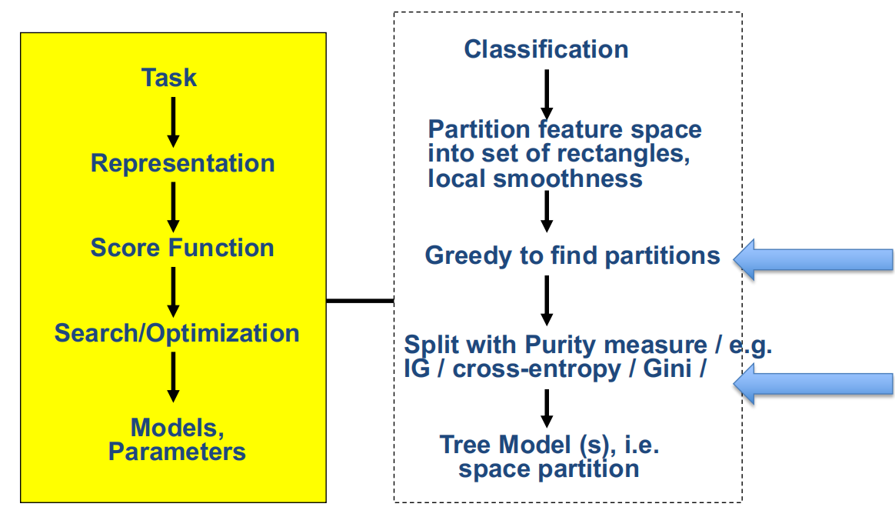
Decision Tree / Random Forest

Slide 39
Today
Decision Tree (DT):
Tree representation
Brief information theory
Learning decision trees
Bagging
Random forests: Ensemble of DT
More about ensemble

Slide 40
Bagging
Bagging or bootstrap aggregation
a technique for reducing the variance of an estimated prediction function.
For instance, for classification, a committee of trees
Each tree casts a vote for the predicted class.

Slide 41
Bootstrap
The basic idea:
randomly draw datasets with replacement (i.e. allows duplicates) from the training data, each samples the same size as the original training set

Slide 42
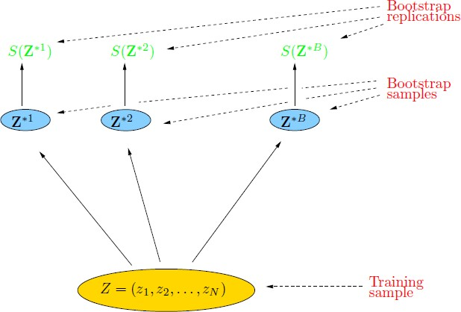

Bootstrap
The basic idea:
randomly draw datasets with replacement (i.e. allows duplicates) from the training data, each samples the same size as the original training set

Slide 43

With vs Without Replacement
Bootstrap with replacement can keep the sampling size the same as the original size for every repeated sampling. The sampled data groups are independent on each other.
Bootstrap without replacement cannot keep the sampling size the same as the original size for every repeated sampling. The sampled data groups are dependent on each other.

Slide 44
Bagging
Create bootstrap samples from the training data
M features
N
N examples
N
N
....…
N

Slide 45
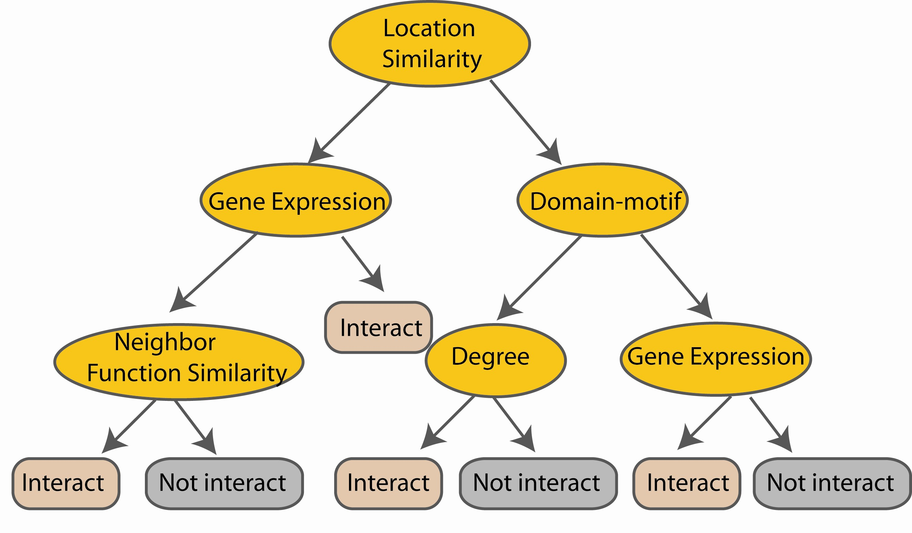
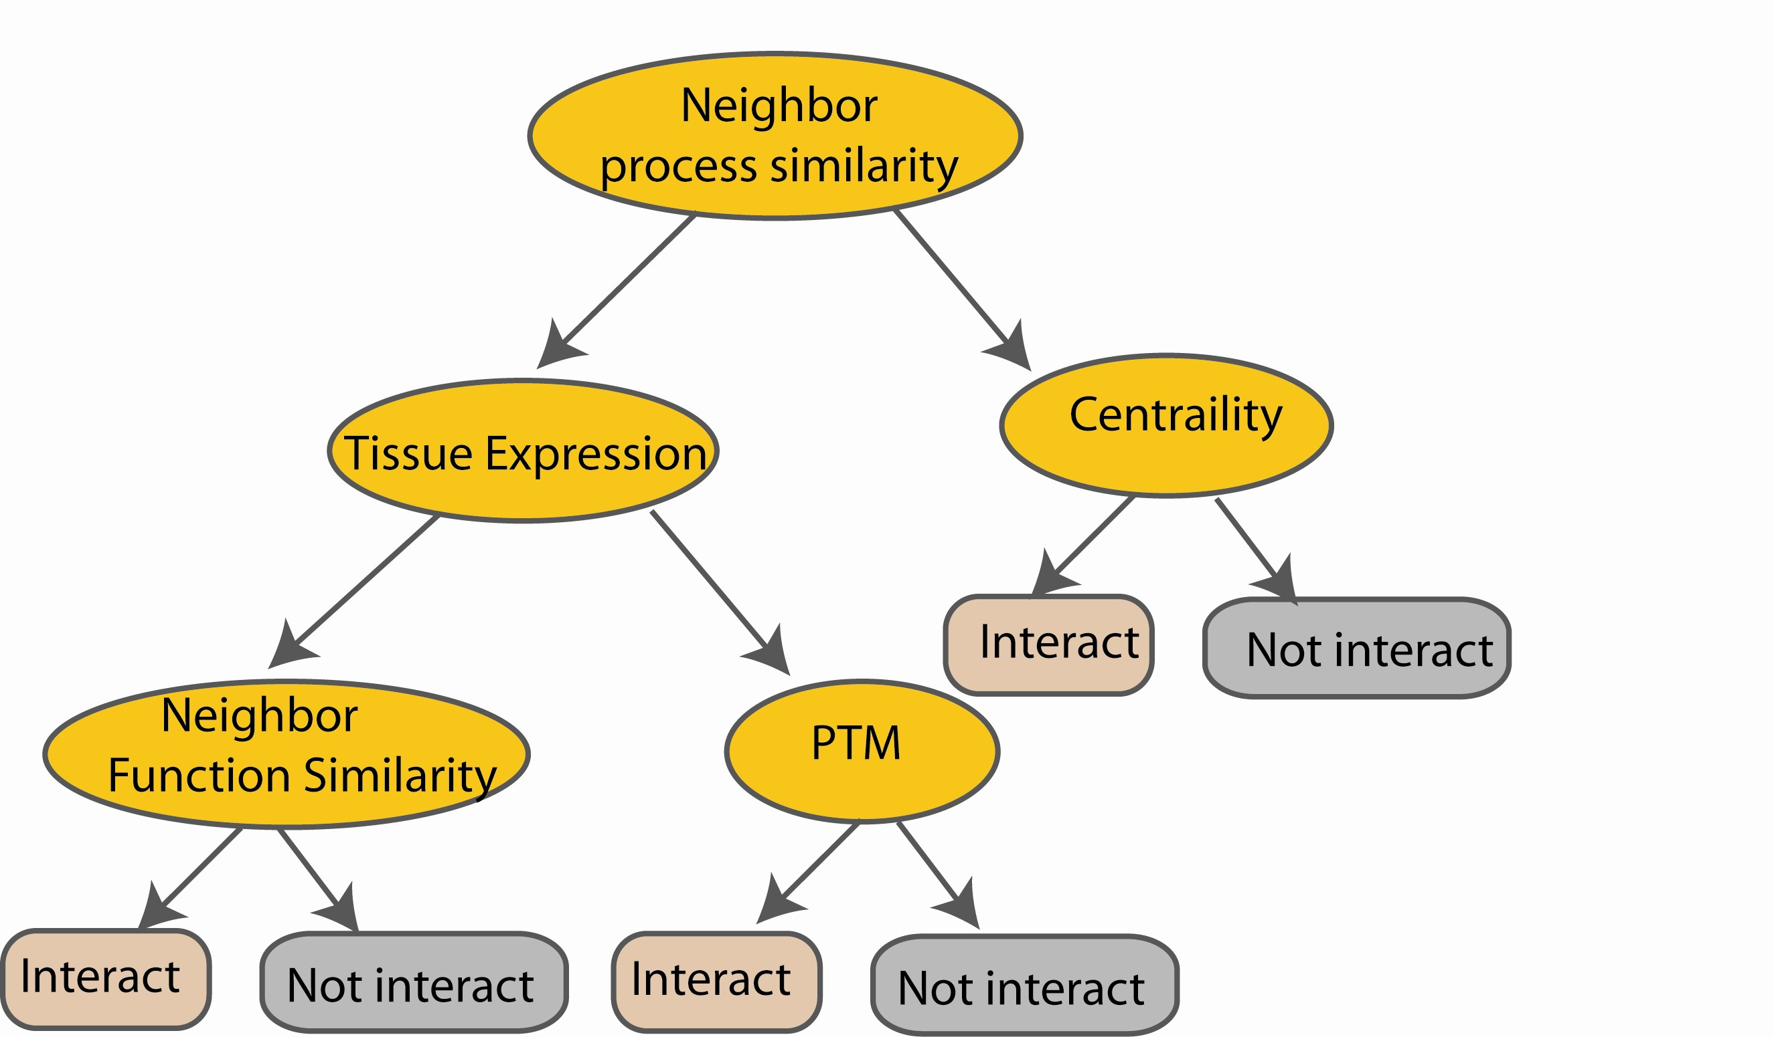
Bagging of DT Classifiers
e.g.
M features
N examples
Take the majority vote
i.e. Refit the model to each bootstrap dataset, and then examine the behavior over the B replications.
....…
....…

Slide 46
Peculiarities of Bagging
Model Instability is good when bagging
The more variable (unstable) the basic model is, the more improvement can potentially be obtained
Low-Variability methods (e.g. SVM, LDA) improve less than High- Variability methods (e.g. decision trees)
Can understand the bagging effect in terms of a consensus of independent weak leaners and wisdom of crowds

Slide 47
Bagging : an example with simulated data
N = 30 training samples,
two classes and p = 5 features,
Each feature N(0, 1) distribution and pairwise correlation .95 Response Y generated according to:
Test sample size of 2000
Fit classification trees to training set and bootstrap samples B = 200

Slide 48
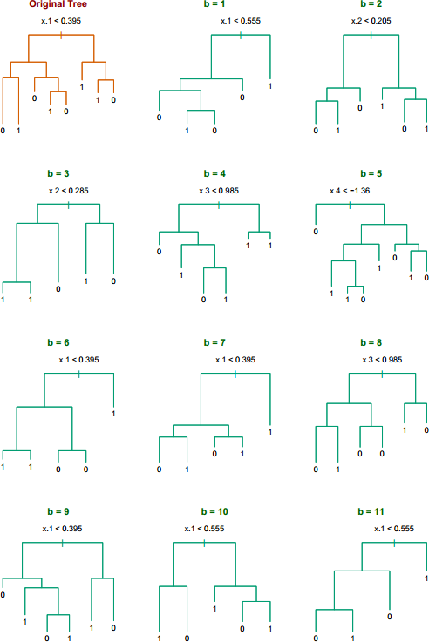
Five features highly correlated with each other
Notice the bootstrap trees are different than the original tree
→ No clear difference with picking up which feature to split
→ Small
changes in the training set will result in different tree
→ But these trees are actually quite similar for classification

Slide 49
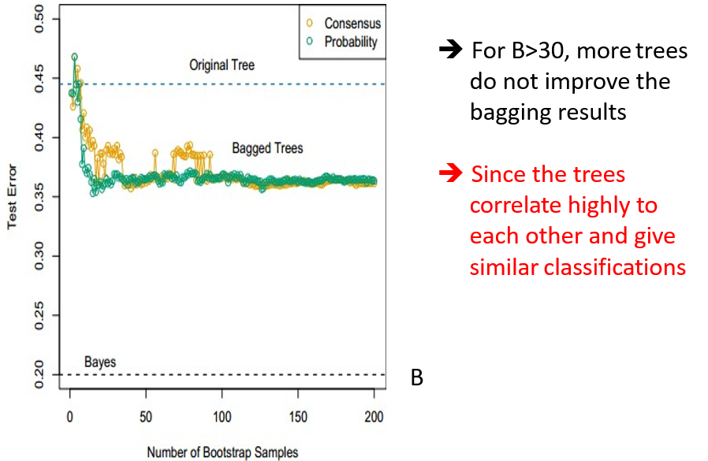
Consensus: Majority vote
Probability: Average distribution at terminal nodes

Slide 50
Bagging
Slightly increases model space
Cannot help where greater enlargement of space is needed
Bagged trees are correlated
Use random forest to reduce correlation between trees

Slide 51
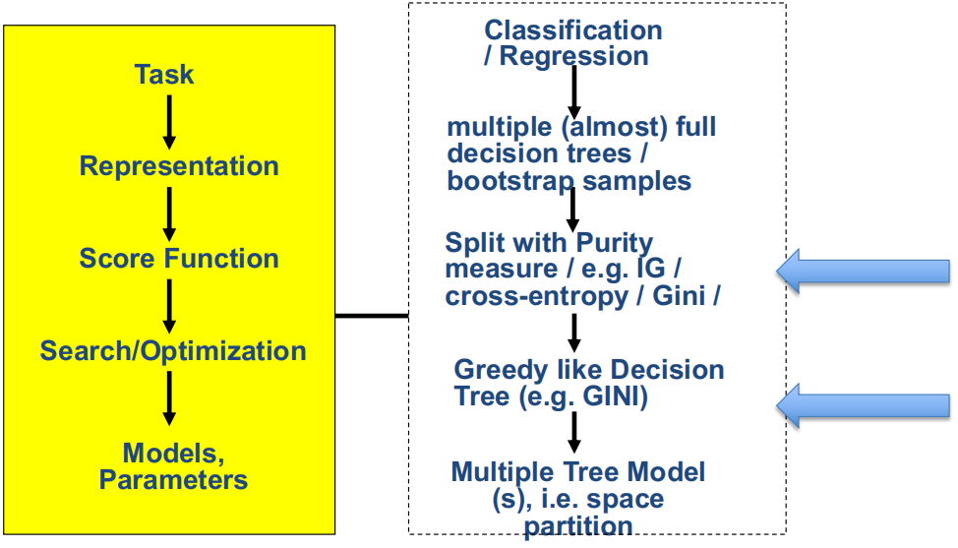
Bagged Decision Tree

Slide 52
References
Prof. Tan, Steinbach, Kumar’s “Introduction to Data Mining” slide
ESLbook : Hastie, Trevor, et al. The elements of statistical learning. Vol. 2. No. 1. New York: Springer, 2009.
Dr. Oznur Tastan’s slides about RF and DT
Dr. Camilo Fosco’s slides

Slide 53
Thanks for listening

